Slide 1

Study, modeling and simulation of pedestrian walk with regard to the improvement of stability and comfort on walkways
School of Electrical & Computer Engineering
Estimating the optimal number of GMM components
Pavlos Paris Giakoumakis
AM: 2013030045
Thesis project - Erasmus+ internship at University of Modena & Reggio Emilia (UNIMORE)

Slide 2

Estimation of GMM Components
The goal is to estimate the optimal number of GMM components needed for the modeling of human walk
Mean force ($F$), Interarrival time ($Δt$) and Length of step ($l$) are correlated, thus a GMM will be fitted in all 3 variables
The optimal number of components should fit a GMM which describes the variables accurately as well as minimize the complexity
The Bayesian (BIC) and Akaike (AIC) information criteria will be used

Slide 3

The Bayesian (BIC) and Akaike (AIC) Information Criteria
The Bayesian information criterion (BIC) is a criterion for model selection among a finite set of models. It is based, in part, on the likelihood function, and it is closely related to the Akaike information criterion (AIC).
Mathematically BIC can be defined as: $BIC=\ln\left(n\right)k−2ln⁡(\hat{L})$
AIC can be defined as: $AIC=2k−2ln⁡(\hat{L})$
$\hat{L}$: The maximized value of the likelihood function of the model
$n$: The number of data points
$k$: the number of parameters to be estimated
A lower AIC and BIC value indicates lower penalty terms hence a better model
BIC considers the number of observations in the formula, which AIC does not.

Slide 4

The Default Method
Each GMM is fitted using $1−15$ components
In each selection, the BIC and AIC values are compared
The lowest AIC/BIC values describe the best model.
The Bayesian (BIC) and Akaike (AIC) information criteria will be used

Slide 5
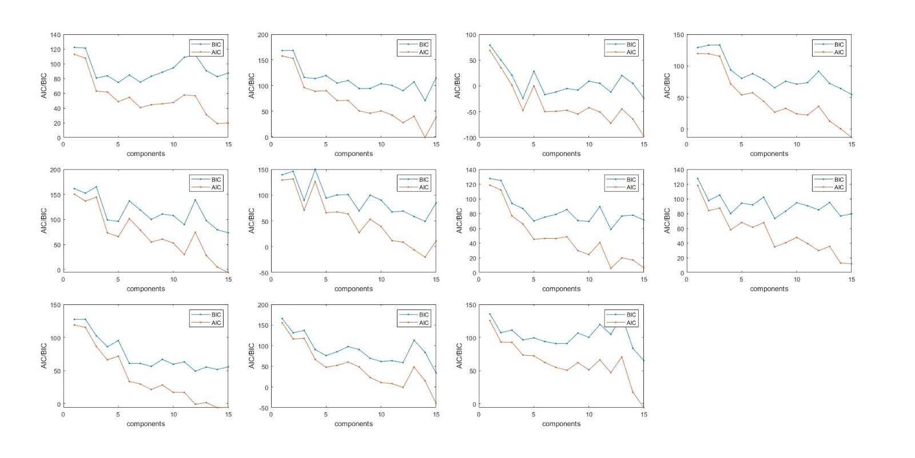

The Default Method
AIC and BIC values for a variety of components on $11$ pedestrians
In most cases, a bigger number of components leads to smaller AIC/BIC values
The penalty AIC/BIC criteria give to complex models leads to overfitting
This phenomenon probably occurs due to the impact of noise in the data
Thus, this method is not optimal for the estimation as it leads to bigger complexity

Slide 6
Exploring a Solution
No need to find a global minimum AIC/BIC score
Detect where the AIC/BIC curve change slope is bigger
This denotes the component number that impacts the fit the most
Therefore can be considered as a descent number of components
Better optimality – complexity payoff is achieved

Slide 7

Fitting on the Unified Histogram
A unified table with all database steps is created
A GMM is fitted on the data
The AIC/BIC values on $1−15$ components are extracted
A different result is produced each time a GMM is fitted
The same procedure is repeated $12$ times in order to get more objective results
A mean histogram is then created
The lowest interval between the AIC/BIC scores denotes the optimal number of components

Slide 8
Fitting on the Unified Histogram

Slide 9
Fitting on the Unified Histogram
Mean histogram
Score intervals

Slide 10

Fitting on the Unified Histogram - Results
The biggest AIC/BIC score improvement (biggest decrease) is spotted on the $3$-component GMM
The same procedure will be followed on random separate pedestrians to identify if the results agree to the $3$-component optimality
The AIC/BIC values on $1−15$ components are extracted
The same procedure is repeated $20$ times (abstract) since a different result is produced each time a GMM is fitted
A mean histogram is then created
The lowest interval between the AIC/BIC scores denotes the optimal number of components

Slide 11

Fitting on Random Pedestrian #$1$

Slide 12

Fitting on Random Pedestrian #$1$
Mean histogram
Score intervals

Slide 13

Fitting on Random Pedestrian #$2$

Slide 14

Fitting on Random Pedestrian #$2$
Mean histogram
Score intervals

Slide 15

Fitting on Random Pedestrian #$3$

Slide 16

Fitting on Random Pedestrian #$3$
Mean histogram
Score intervals

Slide 17

Fitting on Random Pedestrian #$4$

Slide 18

Fitting on Random Pedestrian #$4$
Mean histogram
Score intervals

Slide 19

Fitting on Random Pedestrian #$5$

Slide 20

Fitting on Random Pedestrian #$5$
Mean histogram
Score intervals

Slide 21
Fitting on Random Pedestrian #6

Slide 22
Fitting on Random Pedestrian #6
Mean histogram
Score intervals

Slide 23

Fitting on Random Pedestrian #$7$

Slide 24

Fitting on Random Pedestrian #$7$
Mean histogram
Score intervals

